Slide 1
ADAL & APIM
React Session Management & APIM using Logic App

Slide 2
Agenda
Authentication using ADAL
Session Management
API Management
Logic App

Slide 3
Authentication using ADAL
Azure Active Directory Authentication Library
Authenticate users to cloud or on-premises Active Directory (AD), and obtain tokens for securing API calls.
Features such as:
Configurable token cache that stores access tokens and refresh tokens
Automatic token refresh when an access token expires and a refresh token is available

Slide 4
Session Management
Session-helper Library
It provides methods like –
Expiry – set, get & remove
ExpiryTimeout – start, stop & reset
isTokenExpiredOrNull
expiryTimeoutCallback

Slide 5
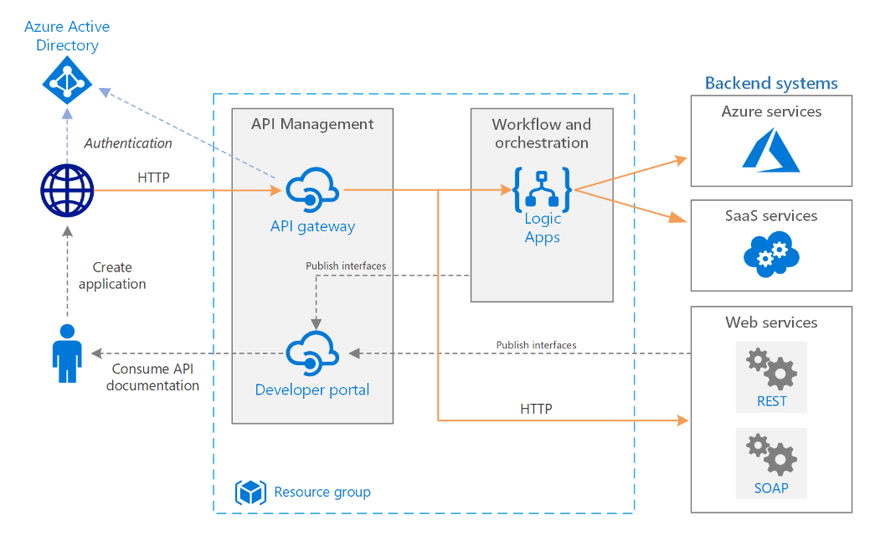
Logic App
Provides a mechanism for application integration and workflow definition in the cloud.
It provides a visual designer for configuring the workflows.
can define a workflow with connectors and logic creation using inbuilt standard connectors.

Slide 6
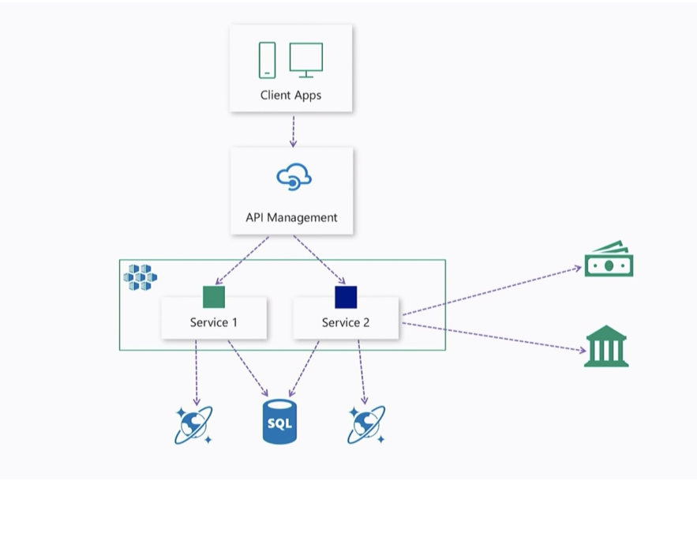
API Management
Azure API Management is a fully managed service that enables customers to publish, secure, transform, maintain, and monitor APIs

Slide 7


Slide 8


